Slide 1
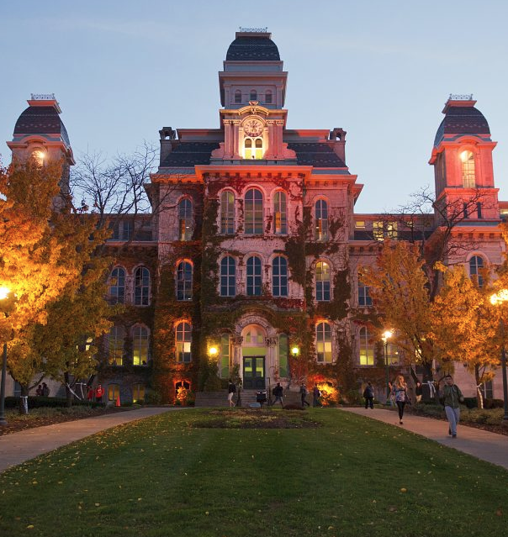
Master of Science
Applied Data Science
Portfolio Milestone
School of Information Studies
Chinmay Ashok Maganur
370801446
30 April 2024 https://github.com/chinmay002/MSADS_Portfolio

Slide 2
Introduction
The Applied Data Science program at Syracuse University’s School of Information Studies provides students the opportunity to collect, manage, analyze, and develop insights using data from a multitude of domains using various tools and techniques.
Reports and presentations were created in courses which exemplify the skills developed in the program including, but not limited to:
IST 659: Database Administration
IST 687: Intro to Data Science
IST 707: Applied Machine Learning
IST 664: Natural Language Processing
IST 736: Text Mining
https://github.com/chinmay002/MSADS_Portfolio

Slide 3
The Applied Data Science Program has seven Learning Objectives:
Describe a broad overview of the major practice areas in data science.
Collect and organize data.
Identify patterns in data via visualization, statistical analysis, and data mining.
Develop alternative strategies based on the data.
Develop a plan of action to implement the business decisions derived from the analyses.
Demonstrate communication skills regarding data and its analysis for relevant professionals in their organization.
Synthesize the ethical dimensions of data science practice.

Slide 4
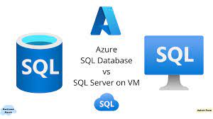
IST 659
Database Administration:
Supply Chain Database using Azure
https://github.com/chinmay002/MSADS_Portfolio/tree/main/IST%20659%20Database%20Administration

Slide 5
IST 659: Database Administration
Introduction
The primary objective of this project is to develop a comprehensive database system for supply chain management, enabling suppliers to continuously monitor relevant statistics and facilitate efficient interactions with customers. The key aspects of this project include:
Record Management: Implement a robust system for monitoring and managing records related to warehouses, stock levels, orders, and other critical supply chain components.
Supplier Interaction: Develop a user-friendly interface that allows suppliers to access and analyze necessary statistics and real-time insights, empowering them to make informed decisions.
Customer Experience: Integrate a dynamic user interface that continuously updates and provides accurate information about available commodities, enabling customers to place and modify orders efficiently.
https://github.com/chinmay002/MSADS_Portfolio/tree/main/IST%20659%20Database%20Administration

Slide 6
IST 659: Database Administration
Modeling, Table Creation, and Reporting
Conceptual and Logical models were developed to organize the relationships between the various members of the database.
SSMS was utilized to create and initially populate the tables.
Stored procedures were created to report various summary statistics.
Microsoft Access was used to facilitate bulk data entry and reporting.
https://github.com/chinmay002/MSADS_Portfolio/tree/main/IST%20659%20Database%20Administration

Slide 7
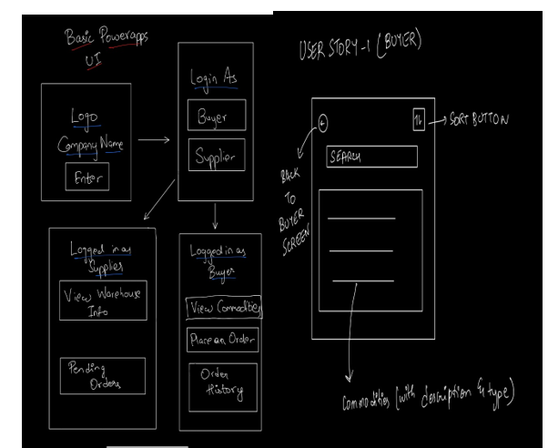
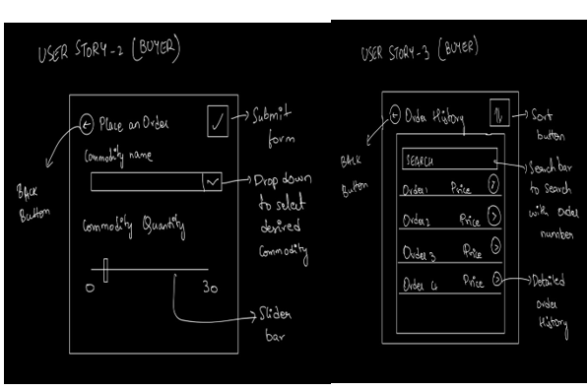
IST 659: Database Administration
User Stories
https://github.com/chinmay002/MSADS_Portfolio/tree/main/IST%20659%20Database%20Administration

Slide 8
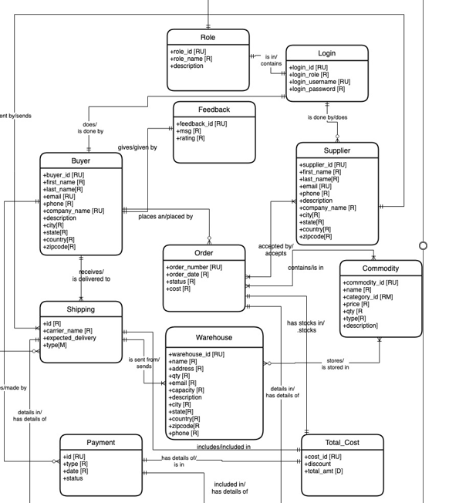
IST 659: Database Administration
Conceptual Models
https://github.com/chinmay002/MSADS_Portfolio/tree/main/IST%20659%20Database%20Administration

Slide 9
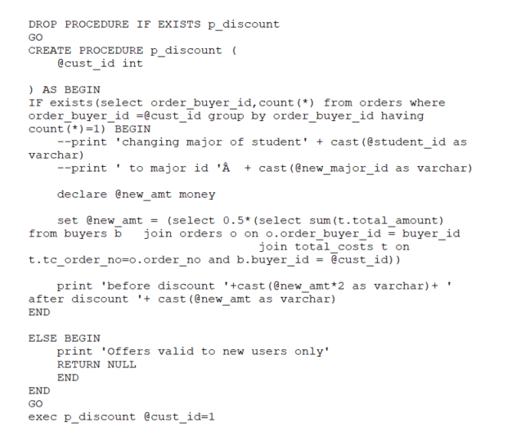
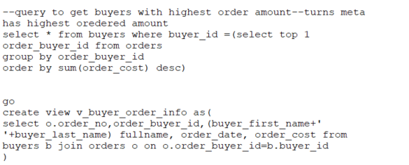
IST 659: Database Administration
https://github.com/chinmay002/MSADS_Portfolio/tree/main/IST%20659%20Database%20Administration

Slide 10
IST 659: Database Administration
Reflection
The exercise of developing a data management solution revealed the significance of how the data is stored and accessed, which is imperative to analysts and data scientists.
This application is applicable to the field of Supply Chain analytics which often requires precise and efficient information management in order to deliver actionable insights.
Enhanced SQL scripting skills by writing complex queries, stored procedures, and triggers to manage and manipulate data efficiently.
Understood and apply database normalization techniques to optimize data storage and eliminate redundancies.
https://github.com/chinmay002/MSADS_Portfolio/tree/main/IST%20659%20Database%20Administration

Slide 11

IST 687
Intro to Data Science:
HealthCare Cost Reduction
https://github.com/chinmay002/MSADS_Portfolio/tree/main/IST%20687%20Intro%20to%20Data%20Science

Slide 12
IST 687 : Health Care Cost Prediction
Introduction
In my first semester project for the Introduction to Data Science course, I embarked on an analytical journey to uncover insights within medical data for a Health Care Cost Prediction. This endeavor not only solidified my foundational skills in data science but also highlighted its pivotal role in transforming healthcare.
In this application, Linear Regression, Support Vector Machines, Decision trees are compared with respect to computation time and accuracy to predict the edibility of mushrooms.
R Studio is leveraged to conduct analysis using data from Kaggle.
https://github.com/chinmay002/MSADS_Portfolio/tree/main/IST%20687%20Intro%20to%20Data%20Science

Slide 13
IST 687 : Health Care Cost Prediction
Methodology
Dealing with missing data points: we removed 158 missing data points in bmi and hypertension variables.
Inspecting the data set: There are 7,502 examples with 14 features related to personal health information (cost, age, bmi, number of children, and etc.)
Performing binning and transformation on variables
Numeric to Categorical: age, bmi
Categorical to Logical: education level, the number of children
Setting the boundary for expensive or not expensive : Since our target value was highly skewed we opted for 3rd quatile as threshold since 97% of people were inside this quartile to convert the numerical values into Categorical values.
So people whose cost was above 4775 were labelled as Expensive , while people with charges below were labelled as Not_Expensive.
https://github.com/chinmay002/MSADS_Portfolio/tree/main/IST%20687%20Intro%20to%20Data%20Science

Slide 14
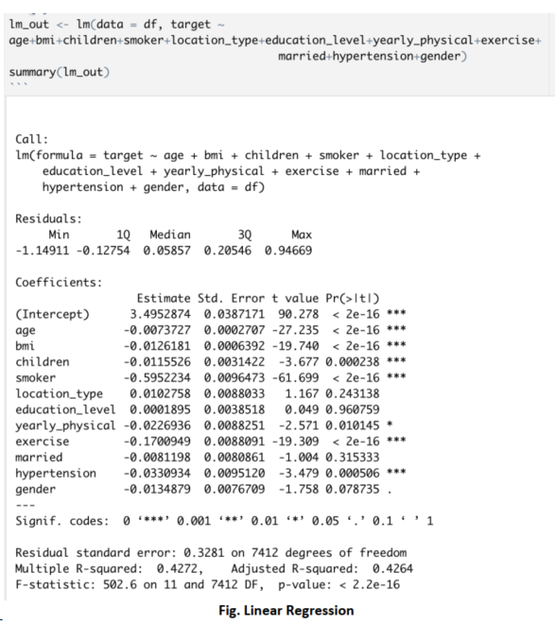
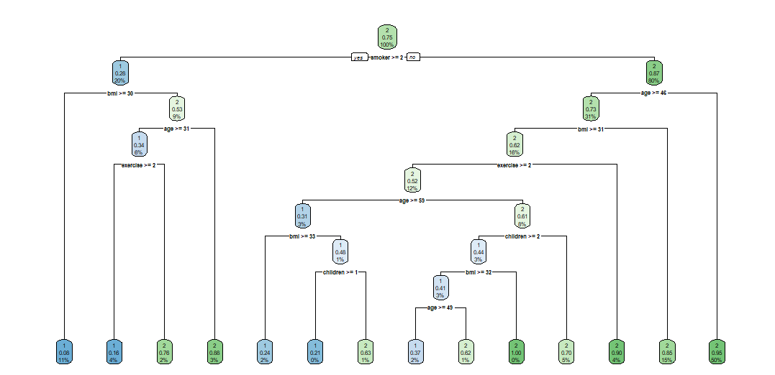
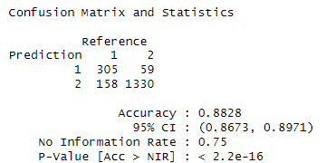
IST 687 : Health Care Cost Prediction
https://github.com/chinmay002/MSADS_Portfolio/tree/main/IST%20687%20Intro%20to%20Data%20Science

Slide 15
IST 687 : Health Care Cost Prediction
Reflection
This project was a profound exploration of the intersection between data science and healthcare.
It not only enhanced my technical prowess in R programming and machine learning but also deepened my understanding of the ethical dimensions of data science.
The insights generated have potential implications for policy-making and operational strategies in healthcare organizations, demonstrating the transformative power of data science in real-world contexts.
By identifying patterns and correlations within the dataset, I contributed to developing strategies aimed at reducing healthcare costs for the HMO
https://github.com/chinmay002/MSADS_Portfolio/tree/main/IST%20687%20Intro%20to%20Data%20Science

Slide 16

IST 736
Text Mining:
Insights from Cancer-Related Discussions on Reddit
https://github.com/chinmay002/MSADS_Portfolio/tree/main/IST%20736%20Text%20Mining

Slide 17
IST 736: Text Mining
Introduction
Through studying Text Mining under the direction of Dr. Bei Yu, data mining techniques were introduced to analyze text and develop insights from unstructured data.
Problem Statement: To extract key insights from unstructured text data within cancer-related online forums and discussions.
Goals:
To analyze the sentiment and emotional tone behind discussions.
To identify prevalent topics and how they align with patient concerns.
To observe trend shifts over time indicating changes in public awareness.
To perform a comparative analysis across different cancer types.
https://github.com/chinmay002/MSADS_Portfolio/tree/main/IST%20736%20Text%20Mining

Slide 18
IST 736: Text Mining
Tasks
Sentiment Analysis
To categorize the sentiment of discussions as positive, negative, or neutral by employing the TF-IDF vectorization method or BERT embeddings for text representation, and then using Support Vector Machines (SVM) or the BERT model for the classification task.
Topic Modeling
We leverage SBERT for semantic embeddings and k-means for preliminary clustering. BerTopic then refines these topics, offering detailed insights.
Trend Analysis
Trend analysis helps in understanding how the popularity of topics changes over time.
Detect emerging discussions around new treatments or changes in community concerns.
Comparative Analysis
To compare the volume and nature of discussions across different types of cancer.
Quantitative analysis of topic occurrence and sentiment across cancer types.
Insights to guide healthcare providers in resource allocation and support services.
https://github.com/chinmay002/MSADS_Portfolio/tree/main/IST%20736%20Text%20Mining

Slide 19
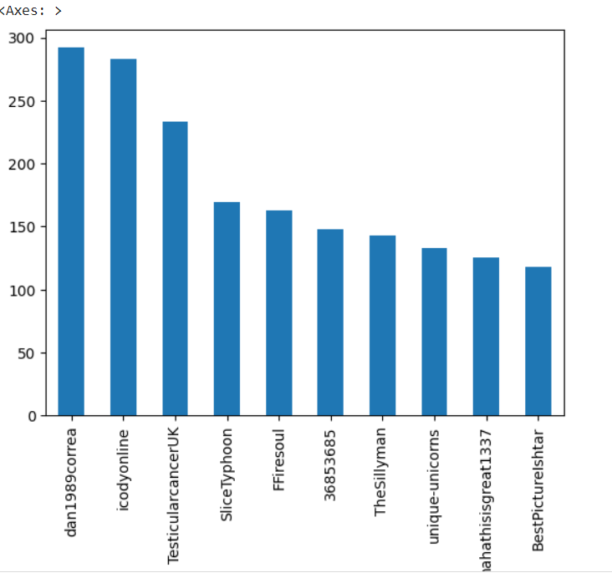
IST 736: Text Mining
BBasic Analysis
Methodology
Authors with most contribution to cancers posts.
https://github.com/chinmay002/MSADS_Portfolio/tree/main/IST%20736%20Text%20Mining

Slide 20
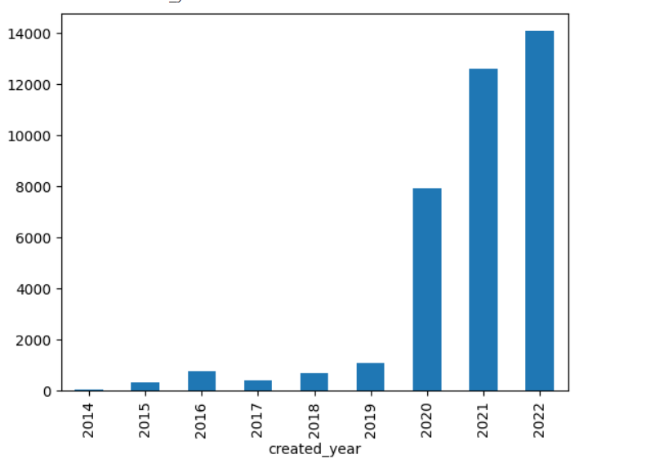
IST 736: Text Mining
Number of Post from each Year
https://github.com/chinmay002/MSADS_Portfolio/tree/main/IST%20736%20Text%20Mining

Slide 21
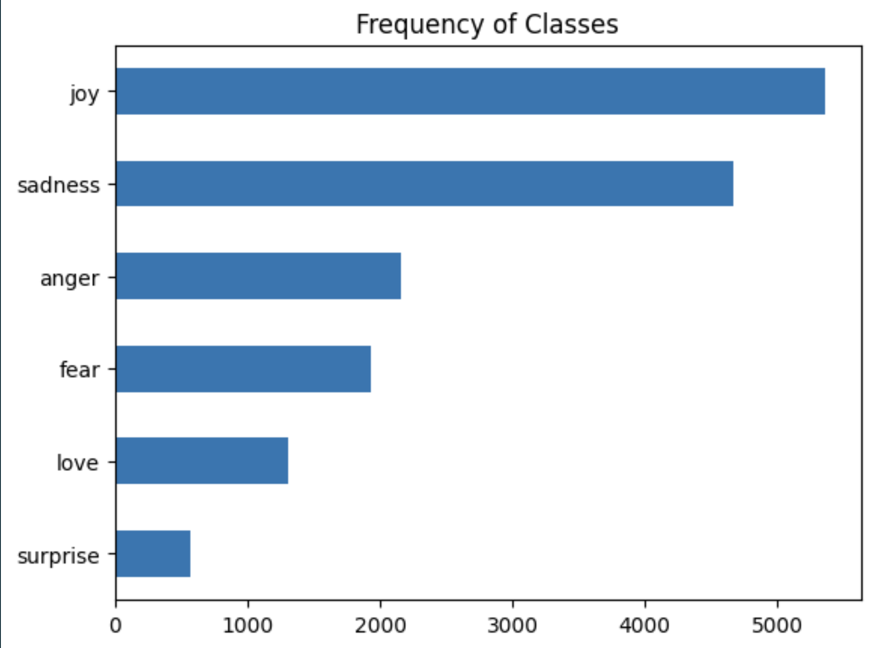
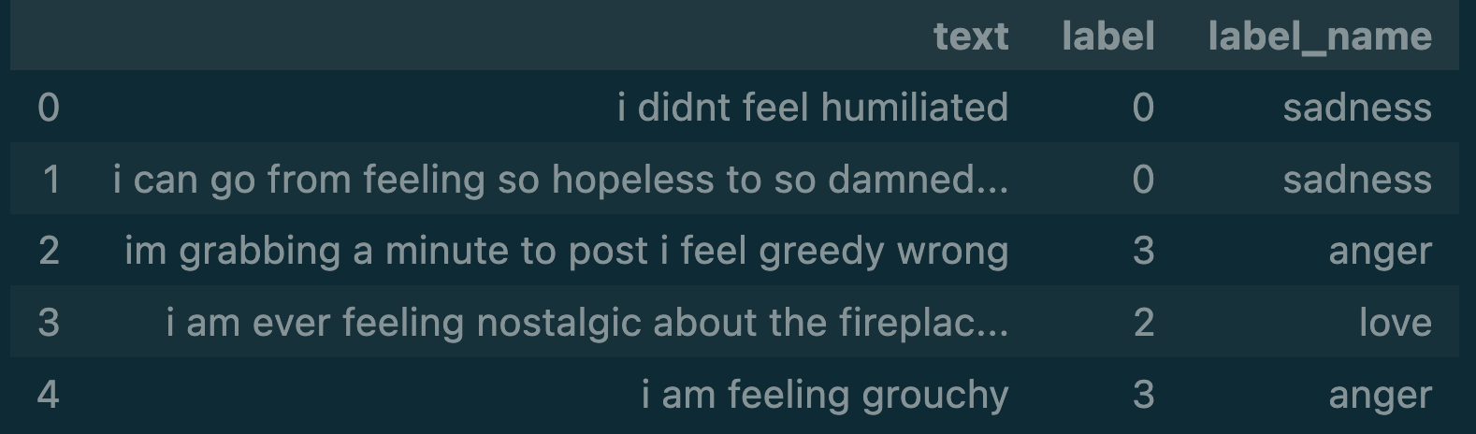
IST 736: Text Mining
Emotion Classifier
https://github.com/chinmay002/MSADS_Portfolio/tree/main/IST%20736%20Text%20Mining

Slide 22
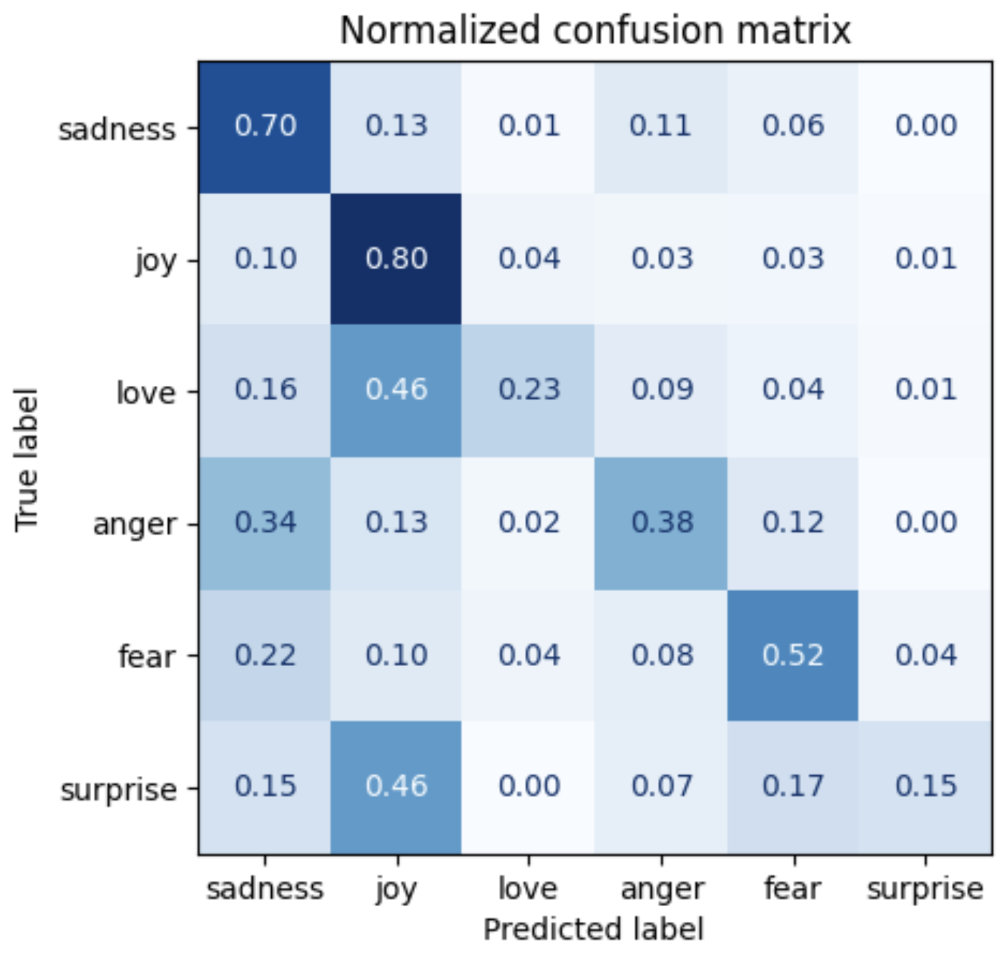
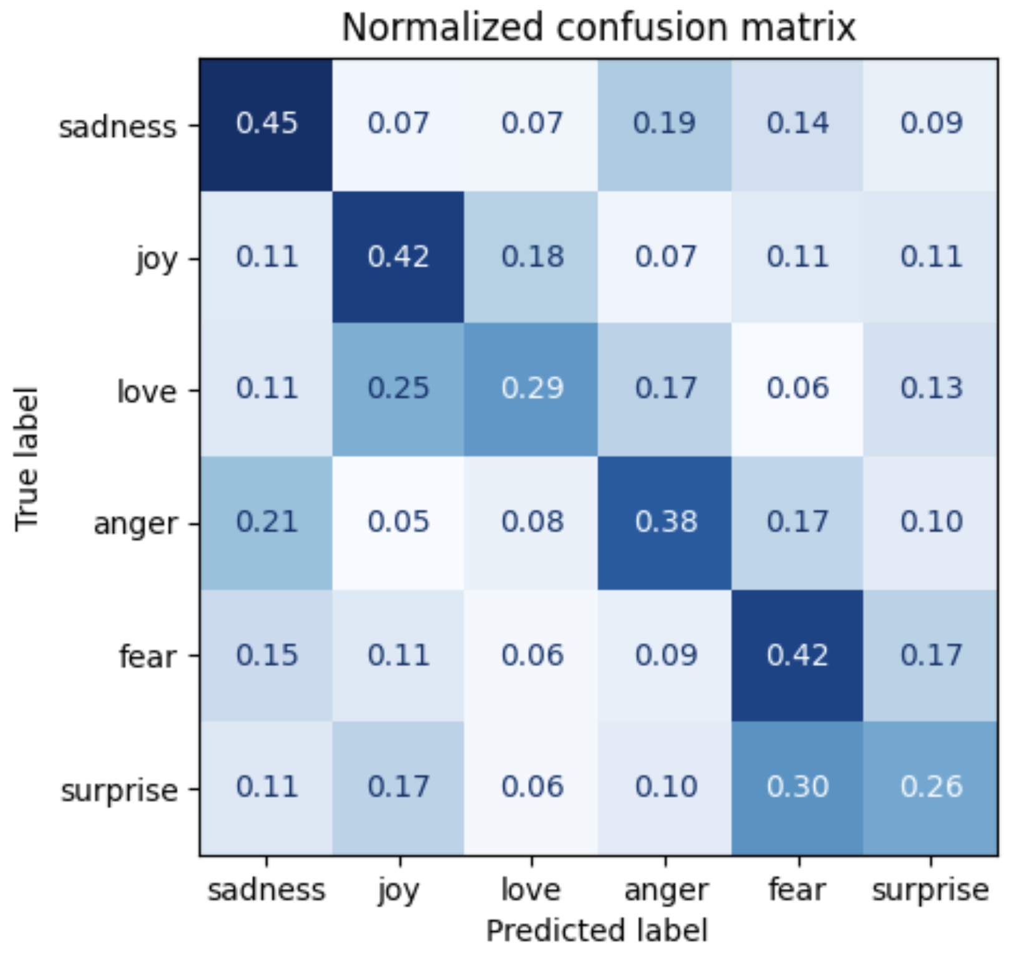
IST 736: Text Mining
Logistic Regression
G MNB
Emotion Classifier Classifier
https://github.com/chinmay002/MSADS_Portfolio/tree/main/IST%20736%20Text%20Mining

Slide 23
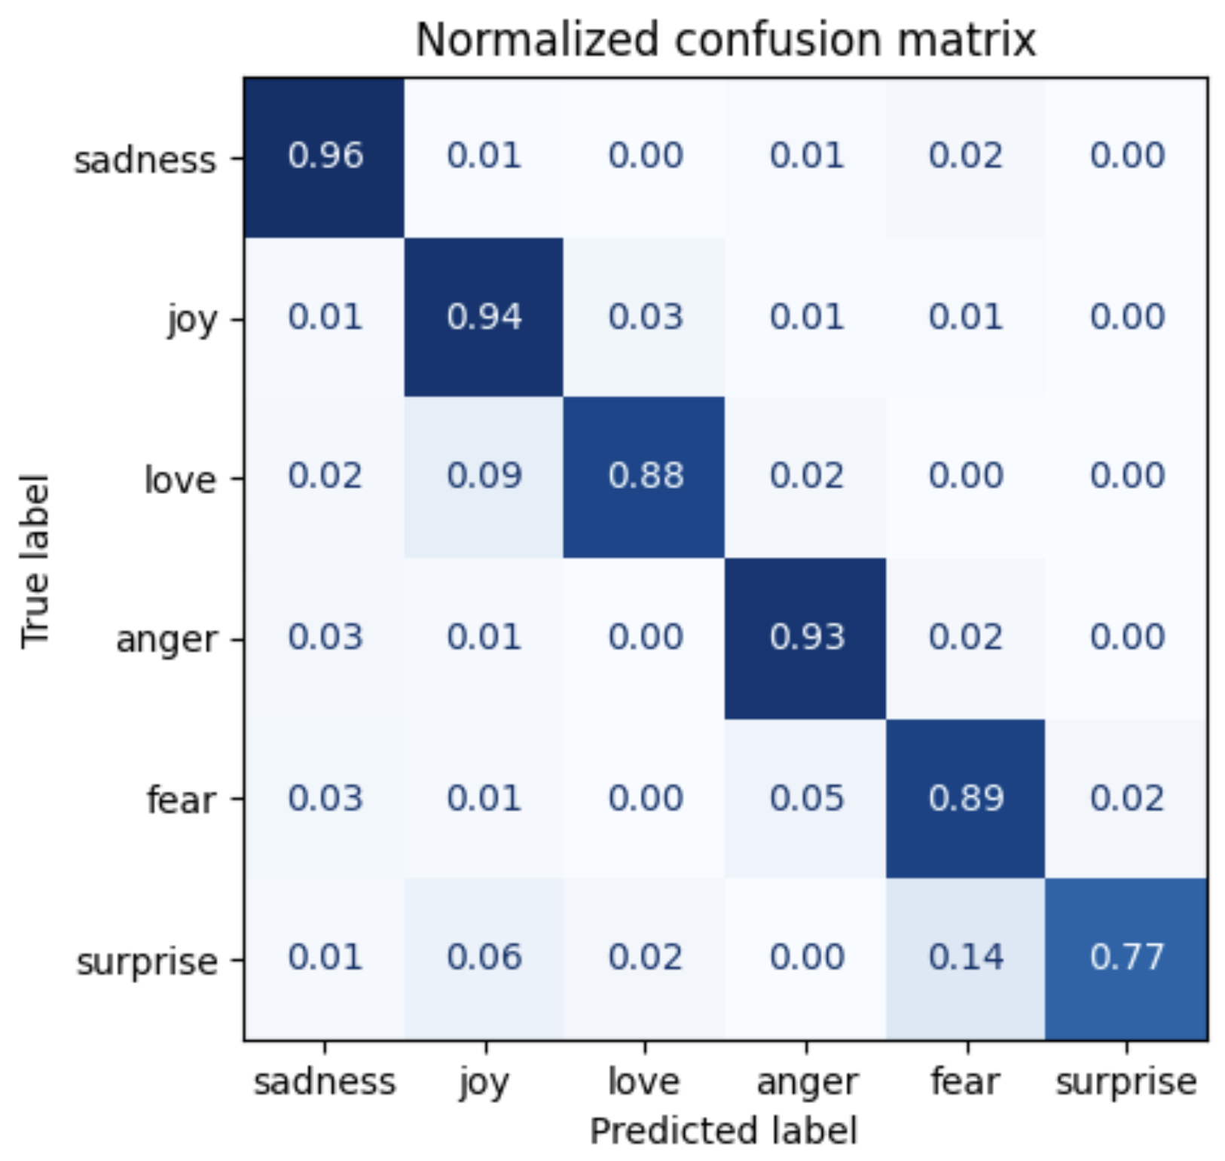
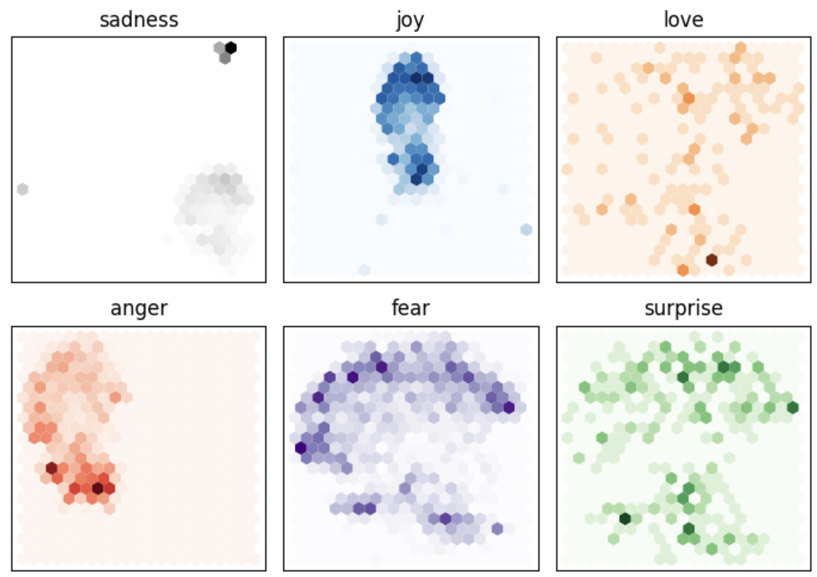
IST 736: Text Mining
F Finetuned Model Model
Logistic Regression
G MNB
Emotion Classifier Classifier
https://github.com/chinmay002/MSADS_Portfolio/tree/main/IST%20736%20Text%20Mining

Slide 24
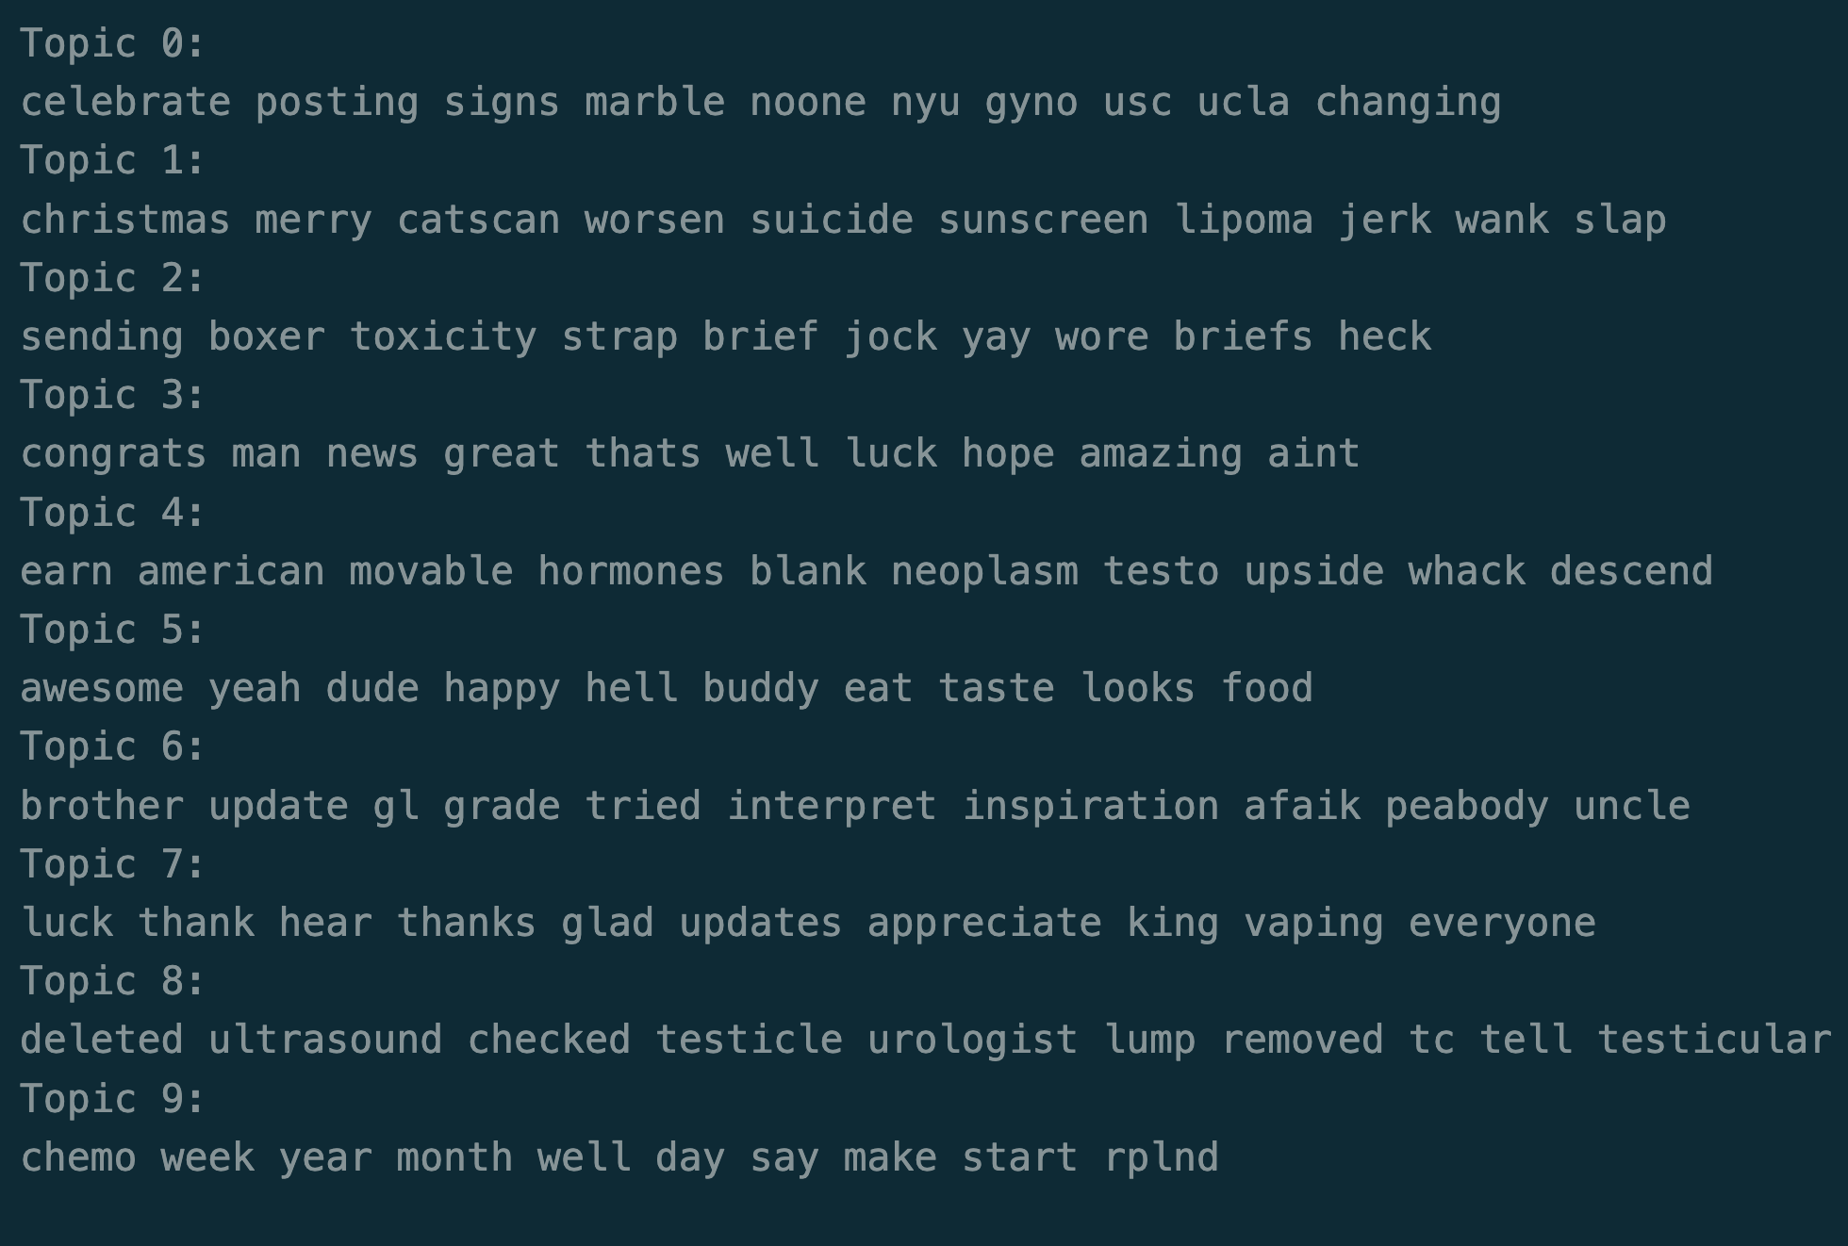
IST 736: Text Mining
F Finetuned Model Model
TF-IDF + LDA
Logistic Regression
G MNB
Emotion Classifier Classifier
https://github.com/chinmay002/MSADS_Portfolio/tree/main/IST%20736%20Text%20Mining

Slide 25
IST 736: Text Mining
F Finetuned Model Model
Cluster #1: "Testicular Health Concerns and Ultrasound Experiences" - This cluster appears to discuss individuals' experiences with testicular health issues, including finding lumps, undergoing ultrasounds, and interactions with healthcare professionals regarding potential testicular cancer or related concerns.
Cluster #2: "Post-Surgical Recovery and Side Effects" - The focus here seems to be on individuals sharing their experiences and advice regarding recovery after surgery, particularly for testicular cancer or related surgeries, including discussions about side effects and managing post-operative care.
Cluster #3: "Testicular Cancer Diagnosis and Treatment Discussions" - This cluster likely contains conversations about the process of being diagnosed with testicular cancer, experiences with treatments, and the emotional and physical impacts of the disease.
Cluster #4: "Support and Encouragement for Testicular Cancer Patients" - This cluster seems to be centered around providing support, sharing personal stories of encouragement, and discussing the emotional journey of those dealing with testicular cancer or related health issues.
Cluster #5: "Testicular Cancer Treatment Options and Decision-Making" - The conversations in this cluster appear to revolve around the different treatment options for testicular cancer,decision-making processes regarding treatments, and discussions about the implications and outcomes of various treatment paths.
TF-IDF + LDA
SBERT
Logistic Regression
G MNB
Emotion Classifier Classifier
https://github.com/chinmay002/MSADS_Portfolio/tree/main/IST%20736%20Text%20Mining

Slide 26
IST 736: Text Mining
Reflection
The project revealed distinct emotional patterns and topics within the cancer-related discussions
Emotion Analysis: The classifier identified a predominant presence of joy, followed by sadness and love, offering insights into the emotional landscape of the discussions.
Topic Insights: Topic modeling unveiled key themes such as health concerns, post-surgical experiences, diagnosis and treatment discussions, and emotional support, highlighting the multifaceted nature of the conversations.
By analyzing cancer-related discussions on Reddit, we gained insights into the prevalent emotions and topics, contributing to a deeper understanding of the collective narratives surrounding cancer.
https://github.com/chinmay002/MSADS_Portfolio/tree/main/IST%20736%20Text%20Mining

Slide 27
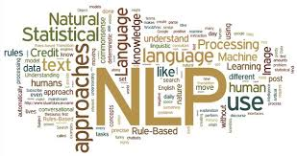
IST 664 Natural Language Processing
Classification of Sincere and Insincere question on Quora
https://github.com/chinmay002/MSADS_Portfolio/tree/main/IST%20664%20Natural%20Language%20Processing

Slide 28
IST 664 Natural Language Processing
Introduction
My project centered on developing a sophisticated model to differentiate between sincere and insincere questions on Quora, addressing the prevalent issue of misinformation and deceitful content on online platforms.
we utilize data analytics to evaluate the legitimacy of a query. Analyzing user-generated content in Online Social Networks (OSNs) has been shown to be a useful application of data analytics.
Data analytics can assist in creating scalable methods to identify fraudulent and misleading content.
https://github.com/chinmay002/MSADS_Portfolio/tree/main/IST%20664%20Natural%20Language%20Processing

Slide 29
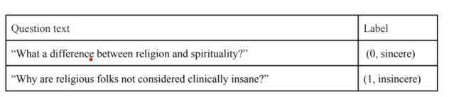
IST 664 Natural Language Processing
Methodology
Each data entry contains the question that was posed as well as whether or not it was deemed to be sincere (label = 1) or not (label = 0)
Investigate how text preprocessing and feature representation can aid in detecting fake news on social media platforms.
Evaluate the performance of various supervised machine learning algorithms, such as decision trees, linear SVC, logistic regression, and random forests, in detecting dishonest content when given various data representations.
Examine the cognitive processes involved in user-generated contributions and how it contributes to identifying fake content
https://github.com/chinmay002/MSADS_Portfolio/tree/main/IST%20664%20Natural%20Language%20Processing

Slide 30
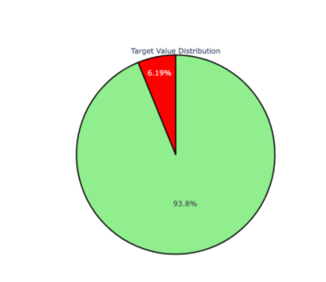
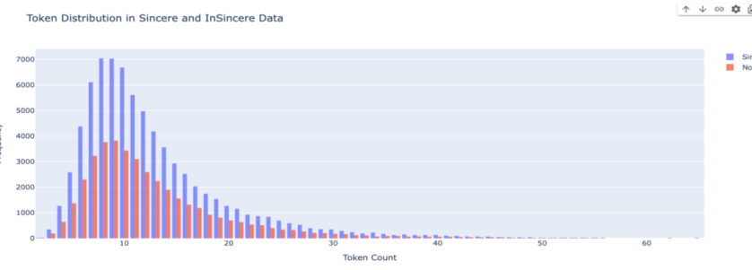
IST 664 Natural Language Processing
Data Analysis
https://github.com/chinmay002/MSADS_Portfolio/tree/main/IST%20664%20Natural%20Language%20Processing

Slide 31
IST 664 Natural Language Processing
TFIDF and Logistic Regression
TFIDF is a widely used technique in natural language processing for text analysis and
information retrieval. The model aims to assign a weight to each term in a document
based on its frequency and rarity in the entire corpus.
TFIDF assigns weights to a token in such a way that the most frequent words are
weighed less as compared to rare words. Most frequent words are ‘the’,’is’,’a’ called
stop words.
Logistic Regression is a classification algorithm that uses sigmoid functions which caps
the value between 0 and 1. In our model we have used TFIDF+Logistic Regression to
predict whether a given question is Sincere or Not.
https://github.com/chinmay002/MSADS_Portfolio/tree/main/IST%20664%20Natural%20Language%20Processing

Slide 32
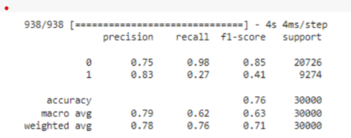
IST 664 Natural Language Processing
TFIDF and Logistic Regression
Bidirectional Long Short Term Memory is a type of RNN which can be used for Sequence-to-Sequence tasks.
Advantage of Using Bi-LSTM over LSTM is that it considers previous as well as future tokens which makes the model more accurate.
We have used embedding dim as 64 with vocab_length the same as above .
Additionally we have used Bi-LSTM of 256 units followed by a Dense layer of 32 units.
This resulted in a f1-score of 71% which was more than Logistic Regression.
https://github.com/chinmay002/MSADS_Portfolio/tree/main/IST%20664%20Natural%20Language%20Processing

Slide 33
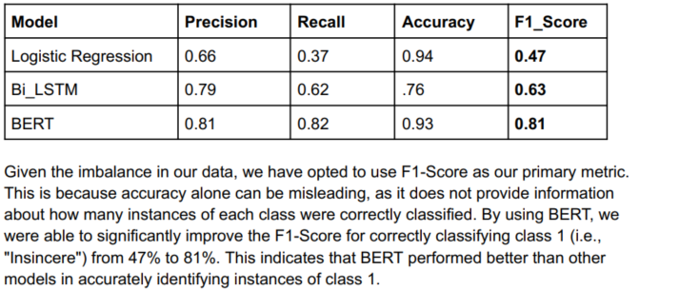
IST 664 Natural Language Processing
BERT
BERT is a Transformers based model that is trained on two tasks mainly Mask prediction and Next sentence Prediction.
It was trained on billions of Data and can be fine tuned according to the required application.
Here we have imported a pre-trained BERT model and tokenizer from Hugging FaceTransformers.
We have reduced the data from 1.3 M rows to 100K rows with class 0 and 1 in proportion 90% and 10% respectively. Due to limitations in Computing resources and memory.
Here we have tokenized the sentences with length 50 . It returns input_ids and attention_mask id
https://github.com/chinmay002/MSADS_Portfolio/tree/main/IST%20664%20Natural%20Language%20Processing

Slide 34
IST 664 Natural Language Processing
Reflection
This project not only enhanced my technical skills in Python and NLP but also highlighted the potential of NLP in moderating online content and fostering healthier digital spaces.
The "Quora Sincere and Insincere Questions Filtering" project was a significant milestone in my academic and professional journey, marking my transition into an NLP enthusiast
It underscored the transformative potential of NLP in addressing real-world challenges and reinforced my commitment to pursuing excellence in this dynamic field of study.
https://github.com/chinmay002/MSADS_Portfolio/tree/main/IST%20664%20Natural%20Language%20Processing

Slide 35
Learning Objectives
IST 659: Database Administration - Logistic Supply Database :Gained comprehensive skills in database system design for supply chain management, including development of entity-relationship diagrams, data models, and SQL scripting to ensure efficient data integrity and stakeholder interaction
IST 687: Introduction to Data Science - Healthcare Cost Prediction : Enhanced understanding of data-driven healthcare analytics, using statistical tools and machine learning models in R to predict healthcare costs and identify key factors affecting healthcare expenditure.
IST 664: Natural Language Processing - Classification of Sincere and Insincere Questions on Quora :Acquired proficiency in natural language processing to differentiate between sincere and insincere content on social media platforms, emphasizing the importance of ethical AI in moderating online interactions.
IST 736: Text Mining - Insights from Cancer-Related Discussions on Reddit : Applied text mining techniques to extract meaningful insights from online health discussions, focusing on emotion classification and topic modeling to support healthcare providers and patients
https://github.com/chinmay002/MSADS_Portfolio

Slide 36
Learning Objectives
Communications skills were displayed in the organization and delivery of insights, expressing them in terms which could be simply understood and acted upon.^{4,5,6,7}
The ethical dimensions of data science practice were displayed and considered when analyzing PII from external sources.
IST 736 required the consideration of user privacy when requesting Tweets from the Twitter API. Only the relevant information was requested to balance both rate limitations and user privacy.⁶
MAR 653 required the consideration of demographic information which was excluded from segmentation, being used only for profiling. This reduces the possibility of introducing bias into the analysis.⁷
Additional study of the ethical dimensions of data science will take part while taking Information Policy in the final term of the program. Topics such as intellectual property and freedom expression will be explored.
These projects are representative of the successful execution of the learning objectives and have developed the necessary skills for practice in the field of data science.
https://github.com/chinmay002/MSADS_Portfolio

Slide 37
Conclusion
Syracuse University’s School of Information Studies provides students the opportunity to synthesize the collection, management, and analysis of data, as well as the delivery of actionable insights using various data science techniques.
Skills learned in the program have developed a multifaceted approach to solving structured and unstructured data problems with increasing complexity.
It has cultivated strategies which improve organizational efficiency.
The program has fostered a practice of transparency, reproducibility, and ethical data management which promotes integrity within an organization’s analytics team.
Using the skills learned in the Applied Data Science program, data scientists are equipped with the ability to tackle a wide range of problems and the resources to explain observations to a variety of stakeholders and business professionals.
https://github.com/chinmay002/MSADS_Portfolio

Slide 38
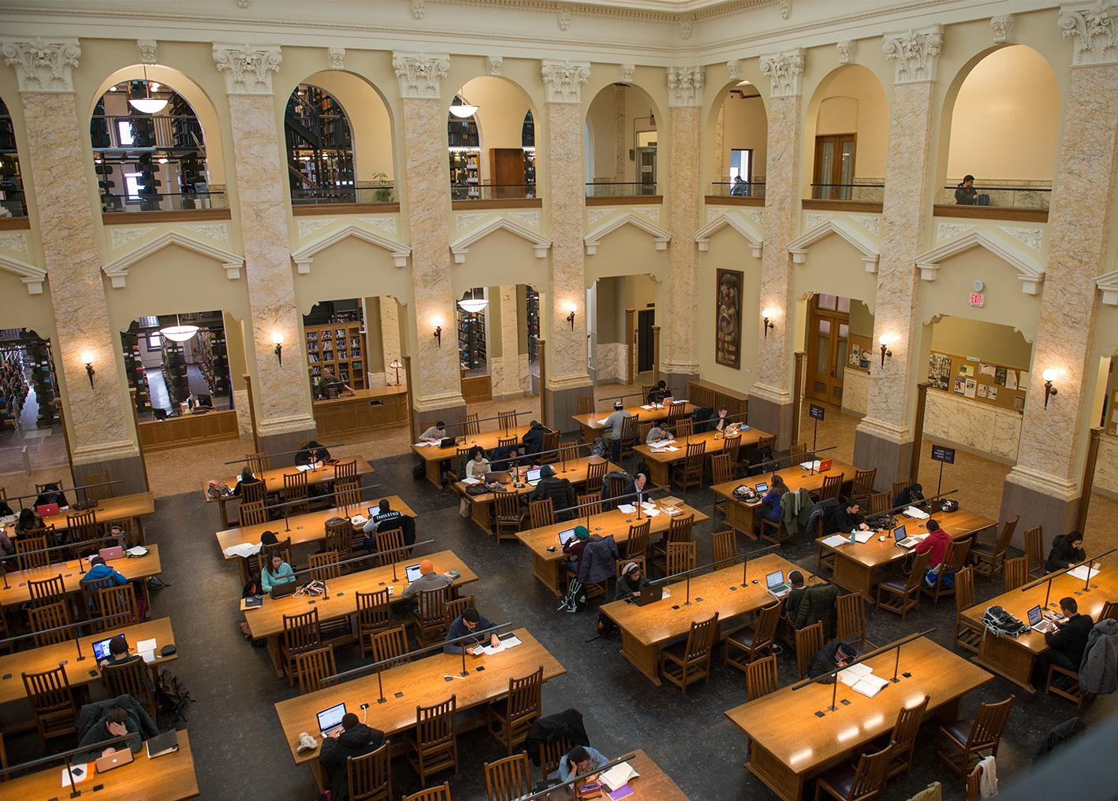
Thank You!
Template Retrieved from:
https://www.syracuse.edu/about/brand/visual-identity/powerpoint-templates/
https://github.com/chinmay002/MSADS_Portfolio

Slide 39
References
https://medium.com/analytics-vidhya/credit-card-fraud-detection-in-python-using-scikit-learn-f9046a030f50
https://github.com/jbofill10/C1_Transaction_Data
https://dsproject-ist687-group3.shinyapps.io/ShinyApp_Group3_IST687/
https://towardsdatascience.com/fine-tuning-bert-for-text-classification-54e7df642894#6ba6
https://www.analyticsvidhya.com/blog/2019/09/demystifying-bert-groundbreaking-nlp-framework/?utm_source=blog&utm_medium=comprehensive-guide-attention-mechanism-deep-learning
https://towardsdatascience.com/multi-label-text-classification-using-bert-and-tensorflow-d2e88d8f488d
https://arxiv.org/pdf/1810.04805.pdf
https://pytorch.org/hub/huggingface_pytorch-transformers/
https://towardsdatascience.com/bert-explained-state-of-the-art-language-model-for-nlp-f8b21a9b6270
https://github.com/chinmay002/MSADS_Portfolio

